Slide 1
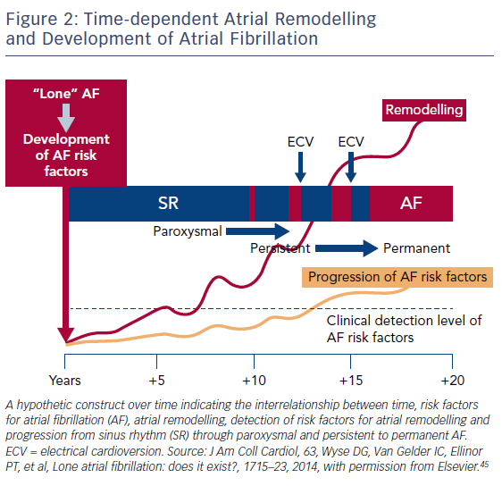
Brandes A, Smit MD, Nguyen BO, Rienstra M, Van Gelder IC
Risk Factor Management in Atrial Fibrillation
Citation: Arrhythmia & Electrophysiology Review 2018;7(2):118–27.
https://doi.org/10.15420/aer.2018.18.2

