Slide 1
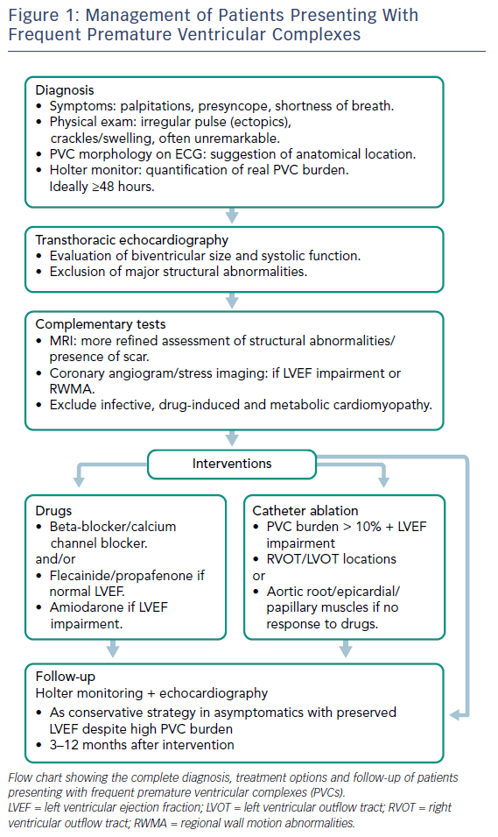
Panizo JG, Barra S, Mellor G, Heck P, Agarwal S
Figure 1: Management of Patients Presenting With Frequent Premature Ventricular Complexes
Citation: Arrhythmia & Electrophysiology Review 2018;7(2):128–34.
https://doi.org/10.15420/aer.2018.23.2

