Slide 1
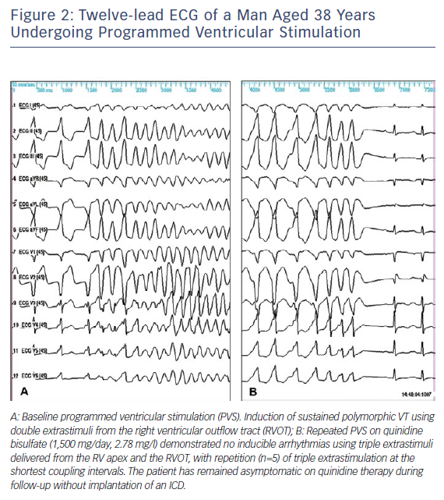
Tovia-Brodie O, Michowitz Y, Belhassen B
Figure 2: Twelve-lead ECG of a Man Aged 38 Years Undergoing Programmed Ventricular Stimulation
Citation: Arrhythmia & Electrophysiology Review 2018;7(2):135–42.
https://doi.org/10.15420/aer.2018.21.2

