Slide 1
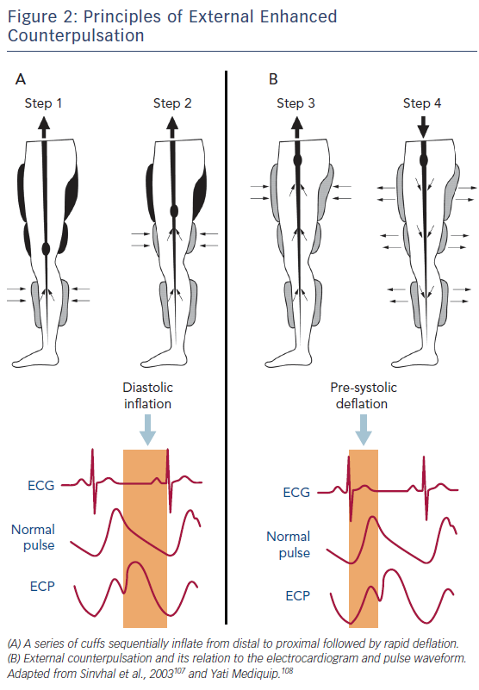
Cheng K, de Silva R
Figure 2: Principles of External Enhanced Counterpulsation
Citation: European Cardiology Review 2018;13(1):70–9.
https://doi.org/10.15420/ecr.2018:1:2

