Slide 1
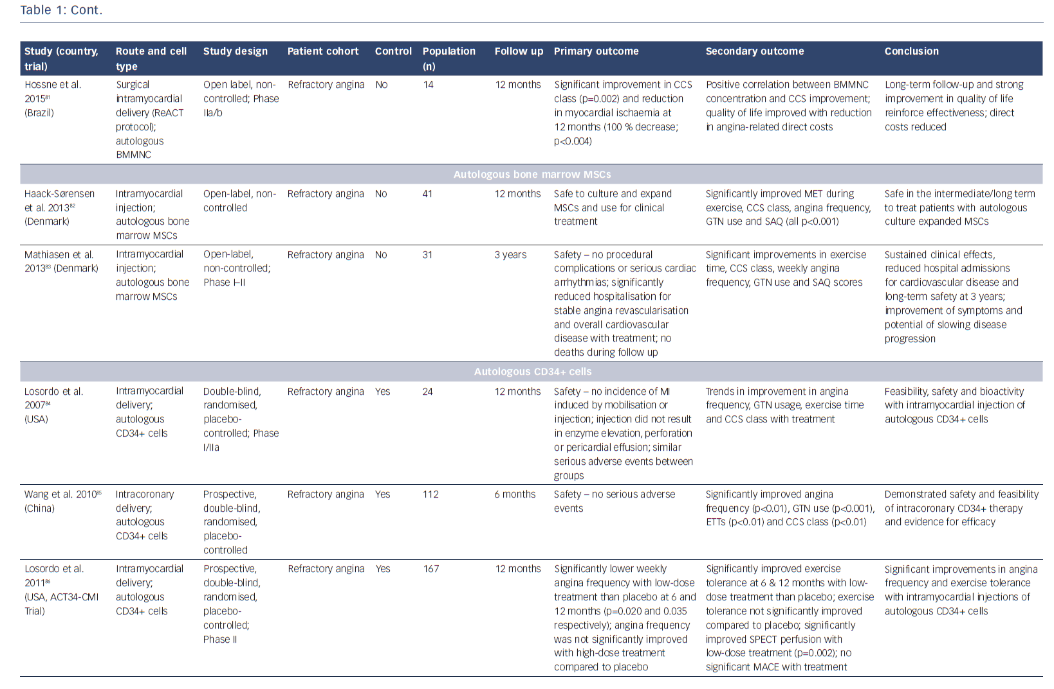
Cheng K, de Silva R
Table 1: Trials of Cell Therapy for Refractory Angina
Citation: European Cardiology Review 2018;13(1):70–9.
https://doi.org/10.15420/ecr.2018:1:2

