Slide 1
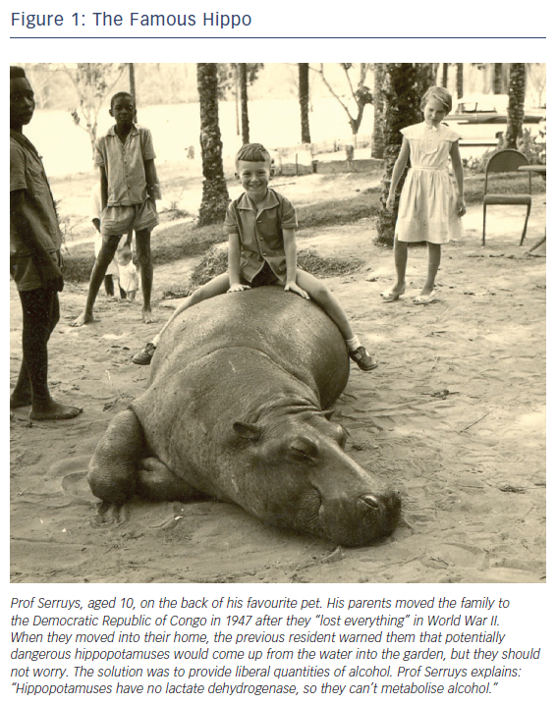
Serruys PW
Figure 1: The Famous Hippo
Citation: European Cardiology Review 2018;13(1):80–2.
https://doi.org/10.15420/ecr.13:2:CM1

