Slide 1
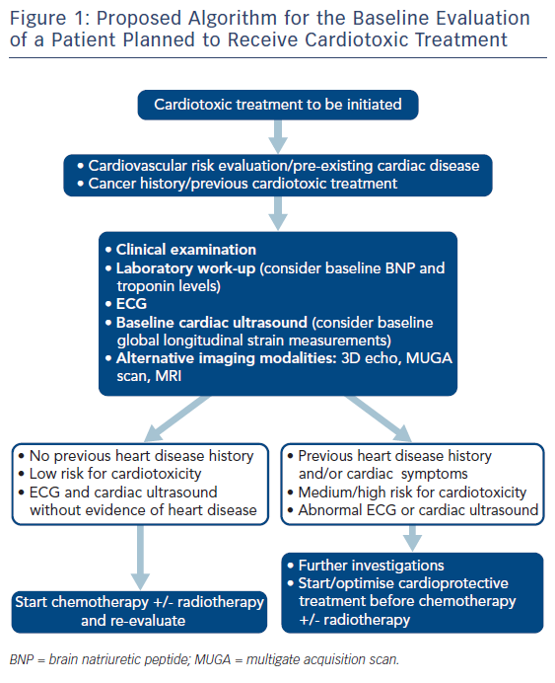
Koutsoukis A, Ntalianis A, Repasos E, Kastritis E, Dimopoulos MA, Paraskevaidis I
Figure 1: Proposed Algorithm for the Baseline Evaluation of a Patient Planned to Receive Cardiotoxic Treatment
Citation: European Cardiology Review 2018;13(1):64–9.
https://doi.org/10.15420/ecr.2017:17:2

