Slide 1
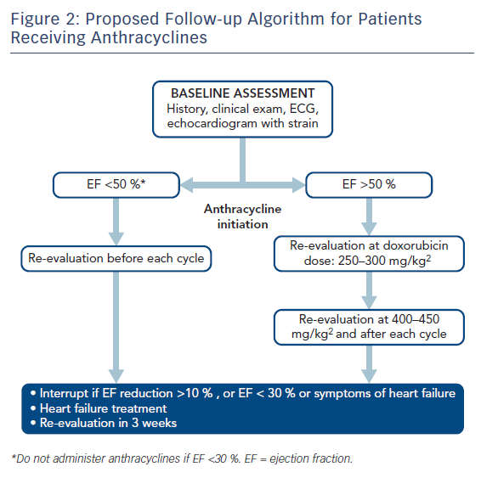
Koutsoukis A, Ntalianis A, Repasos E, Kastritis E, Dimopoulos MA, Paraskevaidis I
Figure 2: Proposed Follow-up Algorithm for Patients Receiving Anthracyclines
Citation: European Cardiology Review 2018;13(1):64–9.
https://doi.org/10.15420/ecr.2017:17:2

