Slide 1
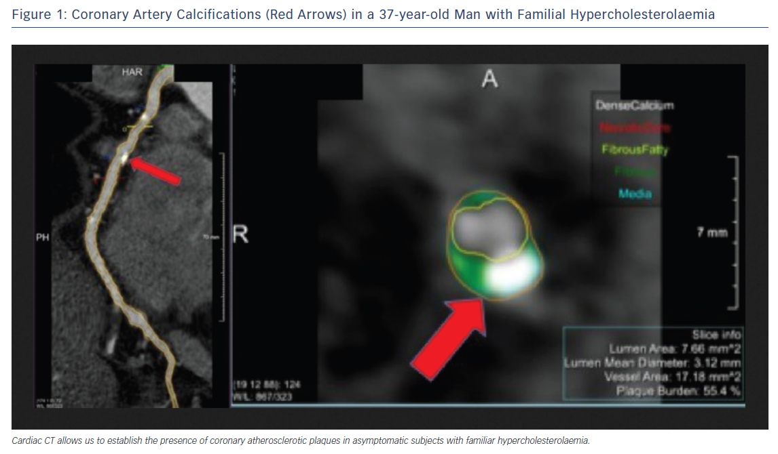
Alonso R, Perez de Isla L, Muñiz-Grijalvo O, Diaz-Diaz JL, Mata P
Figure 1: Coronary Artery Calcifications (Red Arrows) in a 37-year-old Man with Familial Hypercholesterolaemia
Citation: European Cardiology Review 2018;13(1):14–20.
https://doi.org/10.15420/ecr.2018:10:2

