Slide 1
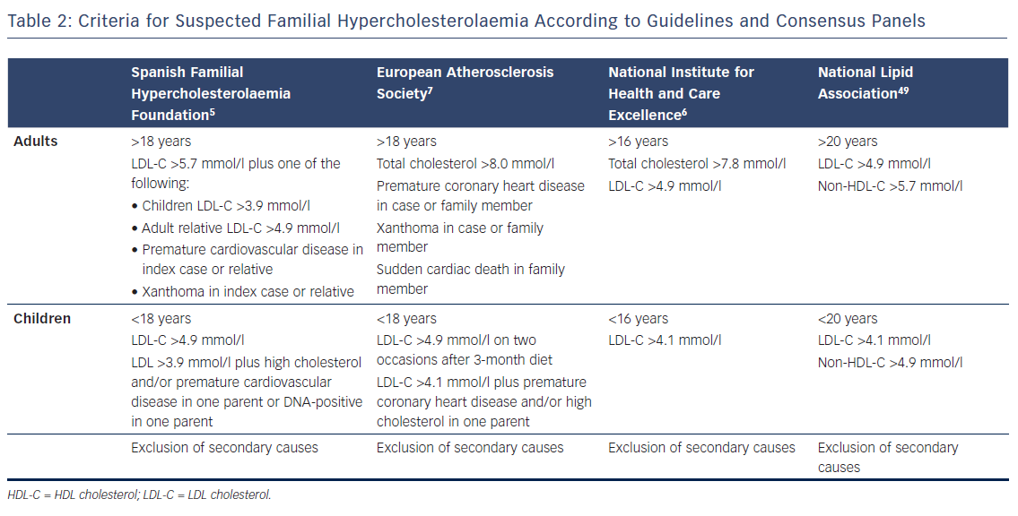
Alonso R, Perez de Isla L, Muñiz-Grijalvo O, Diaz-Diaz JL, Mata P
Table 2: Criteria for Suspected Familial Hypercholesterolaemia According to Guidelines and Consensus Panels
Citation: European Cardiology Review 2018;13(1):14–20.
https://doi.org/10.15420/ecr.2018:10:2

