Slide 1
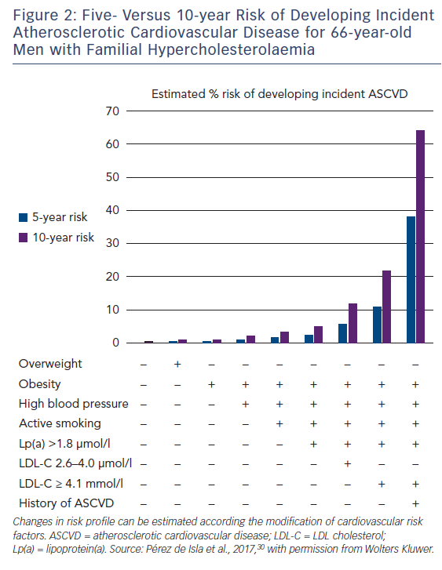
Alonso R, Perez de Isla L, Muñiz-Grijalvo O, Diaz-Diaz JL, Mata P
Figure 2: Five- Versus 10-year Risk of Developing Incident Atherosclerotic Cardiovascular Disease for 66-year-old Men with Familial Hypercholesterolaemia
Citation: European Cardiology Review 2018;13(1):14–20.
https://doi.org/10.15420/ecr.2018:10:2

