Slide 1
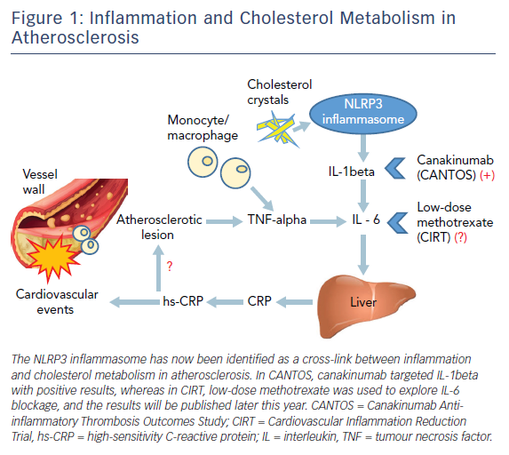
Lorenzatti A, Servato ML
Figure 1: Inflammation and Cholesterol Metabolism in Atherosclerosis
Citation: European Cardiology Review 2018;13(1):38–41.
https://doi.org/10.15420/ecr.2018.11.1

