Slide 1
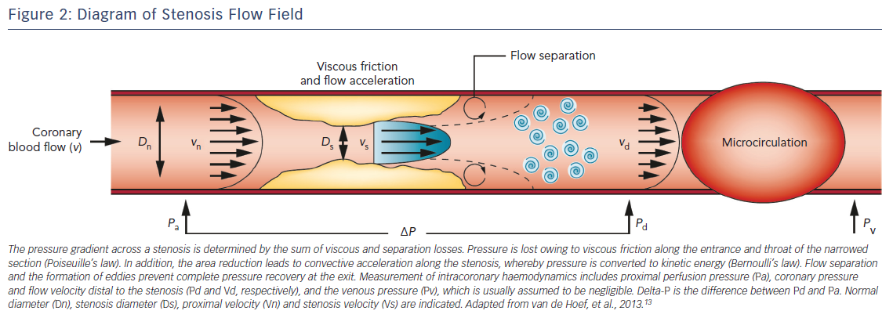
Stegehuis VE, Wijntjens GW, Murai T, Piek JJ, van de Hoef TP
Figure 2: Diagram of Stenosis Flow Field
Citation: European Cardiology Review 2018;13(1):46–53.
https://doi.org/10.15420/ecr.2018:7:2

