Slide 1
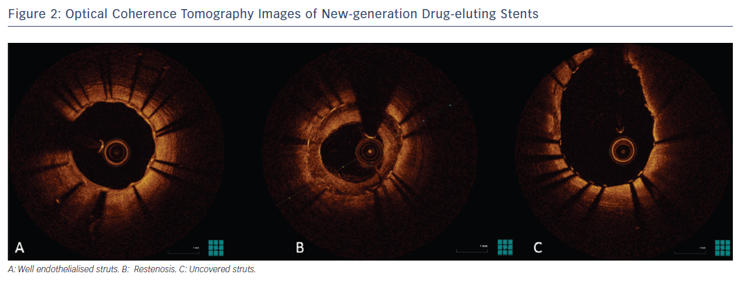
Lee DH, de la Torre Hernández JM
Figure 2: Optical Coherence Tomography Images of New-generation Drug-eluting Stents
Citation: European Cardiology Review 2018;13(1):54–9.
https://doi.org/10.15420/ecr.2018:8:2

