Slide 1
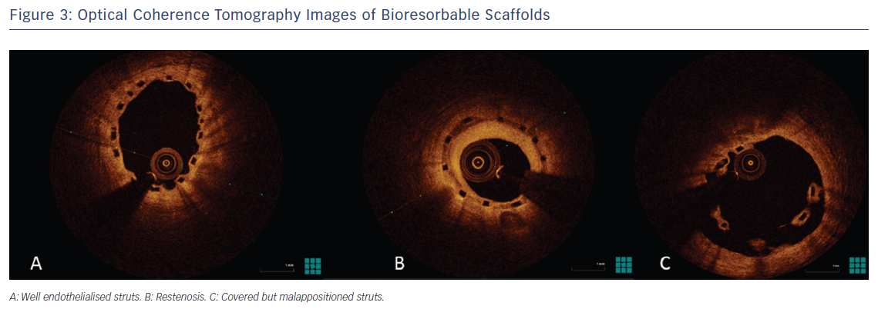
Lee DH, de la Torre Hernández JM
Figure 3: Optical Coherence Tomography Images of Bioresorbable Scaffolds
Citation: European Cardiology Review 2018;13(1):54–9.
https://doi.org/10.15420/ecr.2018:8:2

