Slide 1
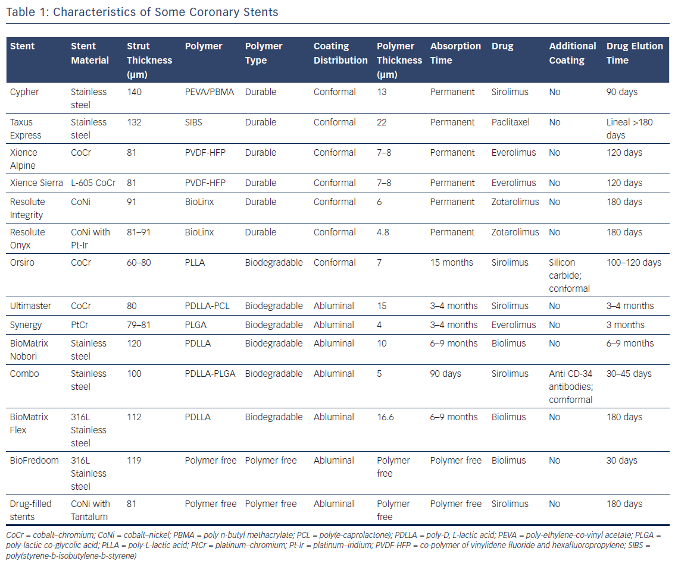
Lee DH, de la Torre Hernández JM
Table 1: Characteristics of Some Coronary Stents
Citation: European Cardiology Review 2018;13(1):54–9.
https://doi.org/10.15420/ecr.2018:8:2

