Slide 1
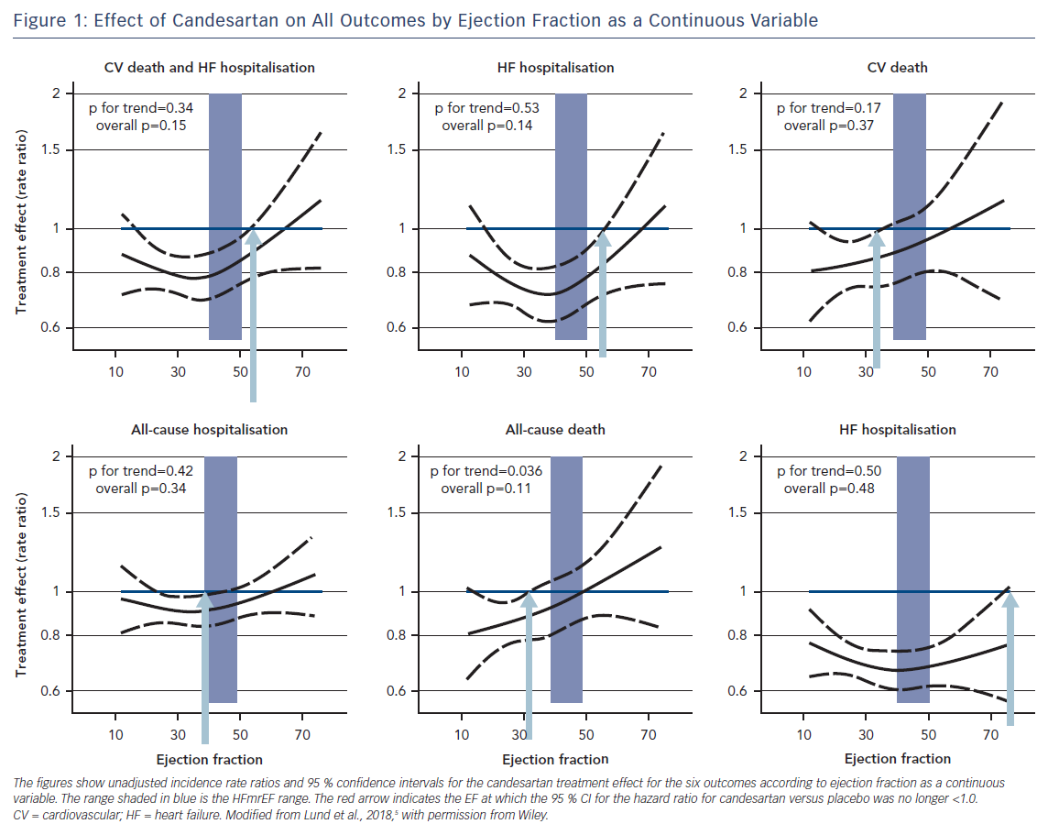
Lund LH
Figure 1: Effect of Candesartan on All Outcomes by Ejection Fraction as a Continuous Variable
Citation: Cardiac Failure Review 2018;4(2):70–2.
https://doi.org/10.15420/cfr.2018.11.2

