Slide 1
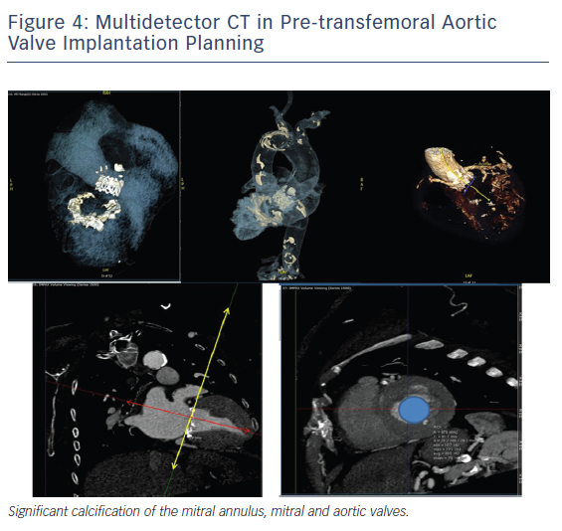
Adigopula S, Grapsa J
Figure 4: Multidetector CT in Pre-transfemoral Aortic Valve Implantation Planning
Citation: Cardiac Failure Review 2018;4(2):73–7.
https://doi.org/10.15420/cfr.2018.5.2

