Slide 1
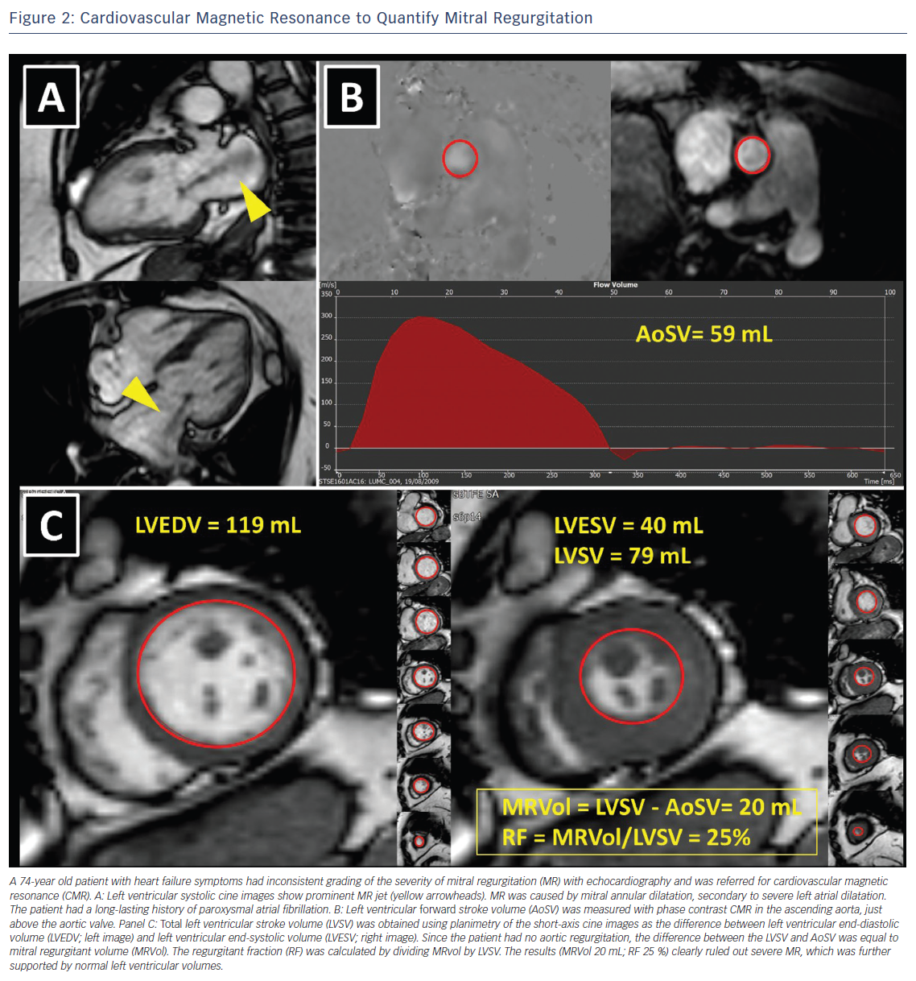
Podlesnikar T, Delgado V, Bax JJ
Figure 2: Cardiovascular Magnetic Resonance to Quantify Mitral Regurgitation
Citation: Cardiac Failure Review 2018;4(2):78–86.
https://doi.org/10.15420/cfr.2018.16.1

