Slide 1
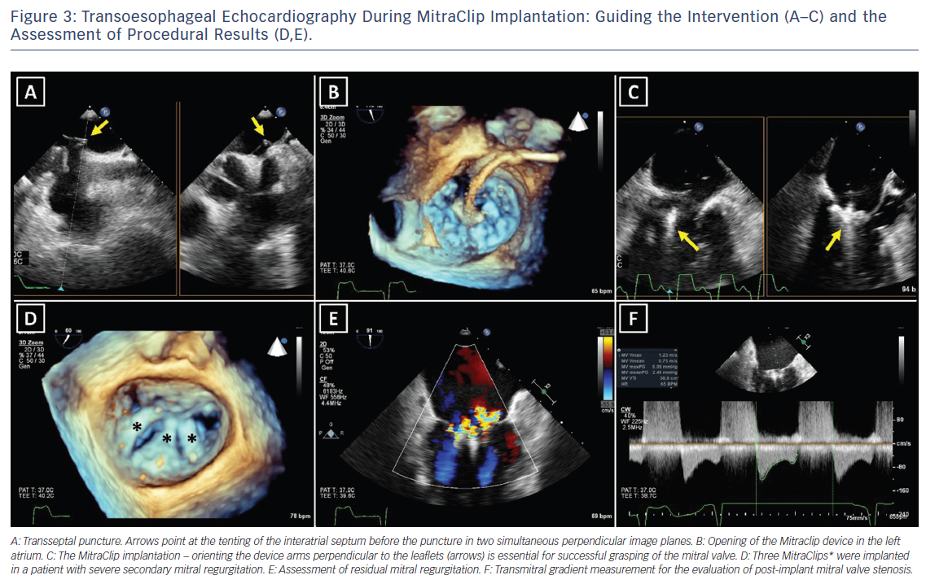
Podlesnikar T, Delgado V, Bax JJ
Figure 3: Transoesophageal Echocardiography During MitraClip Implantation: Guiding the Intervention (A–C) and the Assessment of Procedural Results (D,E).
Citation: Cardiac Failure Review 2018;4(2):78–86.
https://doi.org/10.15420/cfr.2018.16.1

