Slide 1
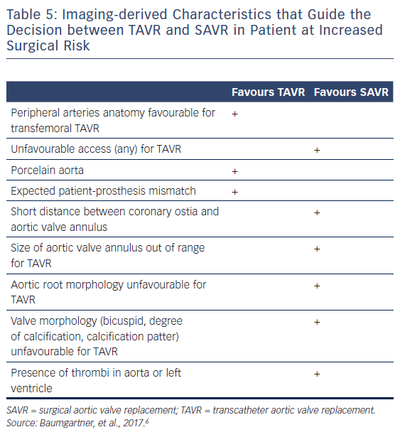
Podlesnikar T, Delgado V, Bax JJ
Table 5: Imaging-derived Characteristics that Guide the Decision between TAVR and SAVR in Patient at Increased Surgical Risk
Citation: Cardiac Failure Review 2018;4(2):78–86.
https://doi.org/10.15420/cfr.2018.16.1

