Slide 1
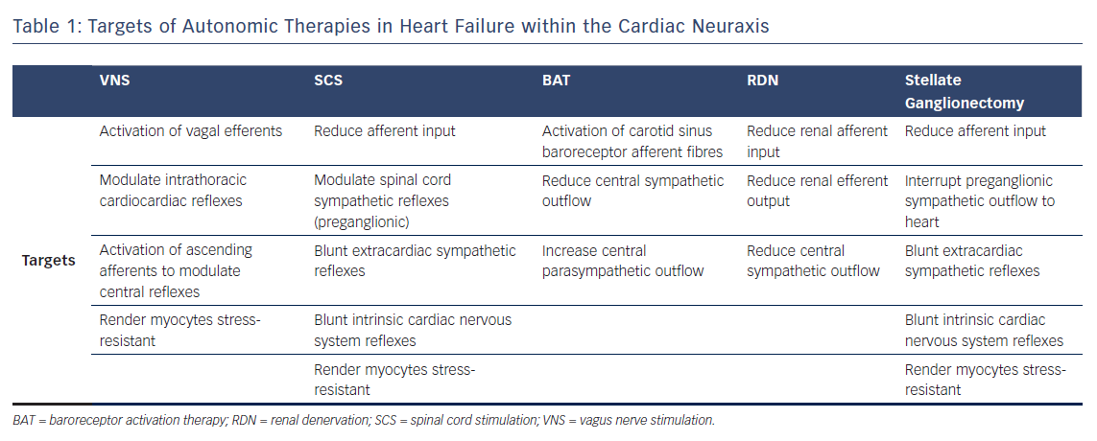
Hanna P, Shivkumar K, Ardell JL
Table 1: Targets of Autonomic Therapies in Heart Failure within the Cardiac Neuraxis
Citation: Cardiac Failure Review 2018;4(2):92–8.
https://doi.org/10.15420/cfr.2018.20.2

