Slide 1

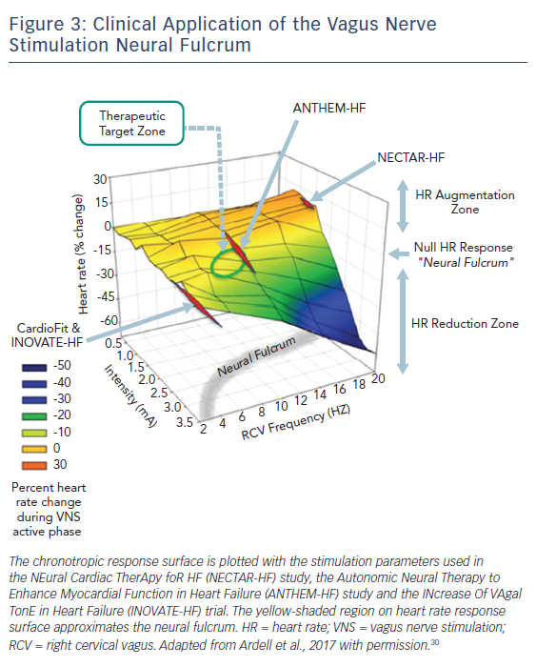
Hanna P, Shivkumar K, Ardell JL
Figure 3: Clinical Application of the Vagus Nerve Stimulation Neural Fulcrum
Citation: Cardiac Failure Review 2018;4(2):92–8.
https://doi.org/10.15420/cfr.2018.20.2

