Slide 1
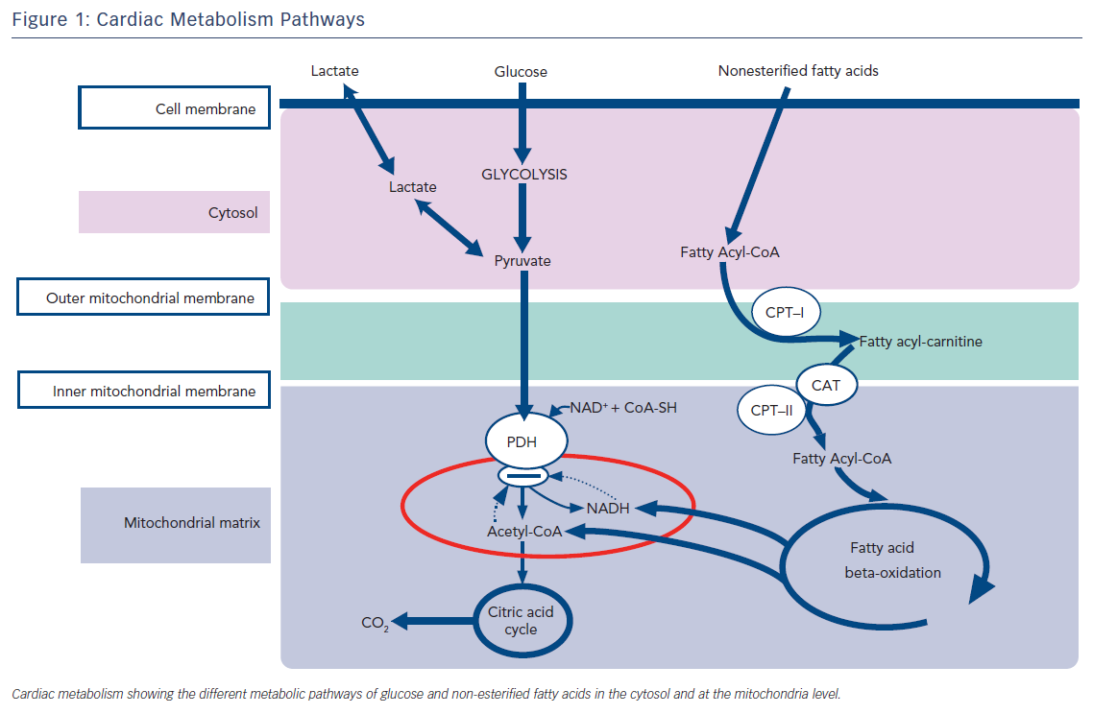
Rosano G, Vitale C
Figure 1: Cardiac Metabolism Pathways
Citation: Cardiac Failure Review 2018;4(2):99–103.
https://doi.org/10.15420/cfr.2018.18.2

