Slide 1
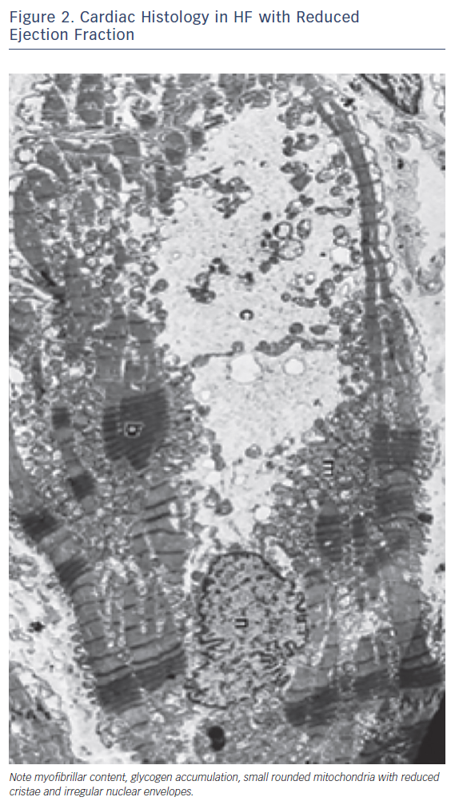
Rosano G, Vitale C
Figure 2. Cardiac Histology in HF with Reduced Ejection Fraction
Citation: Cardiac Failure Review 2018;4(2):99–103.
https://doi.org/10.15420/cfr.2018.18.2

