Slide 1
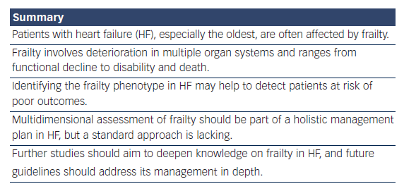
Vitale C, Spoletini I, Rosano G
Summary
Citation: Cardiac Failure Review 2018;4(2):104–6.
https://doi.org/10.15420/cfr.2018.22.2

