Slide 1
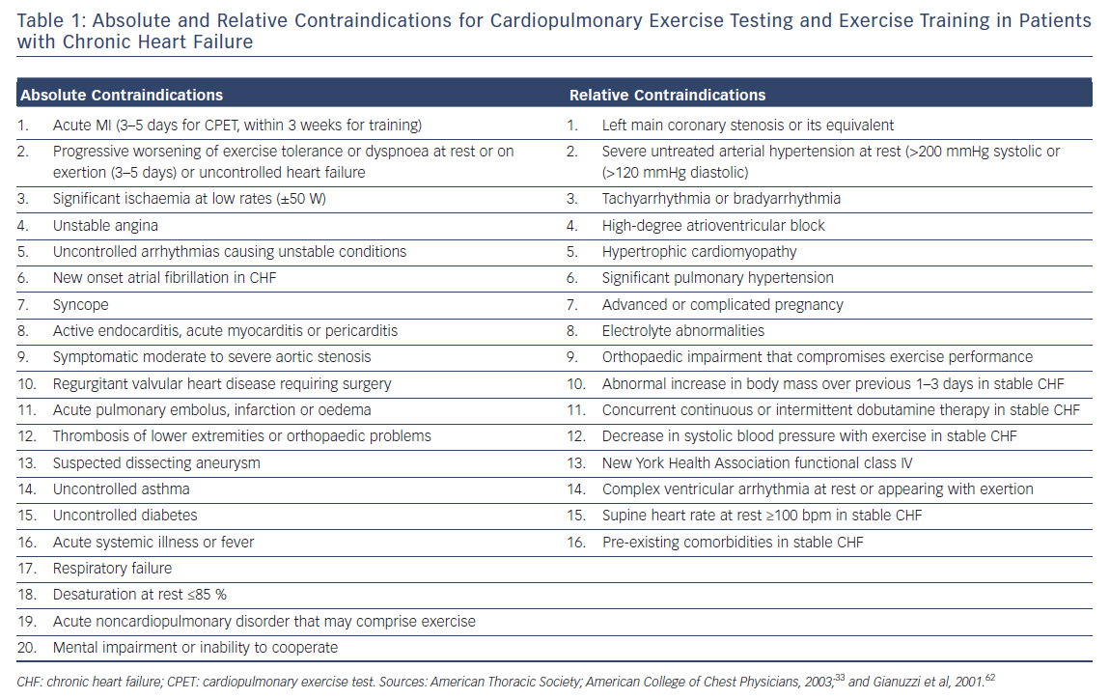
Cornelis J, Myers J, Heidbuchel H, Vrints C, Beckers P
Absolute & Relative Contraindications for Cardiopulmonary
Citation: Cardiac Failure Review 2018;4(2):107–11.
https://doi.org/10.15420/cfr.2018.19.2

