Slide 1
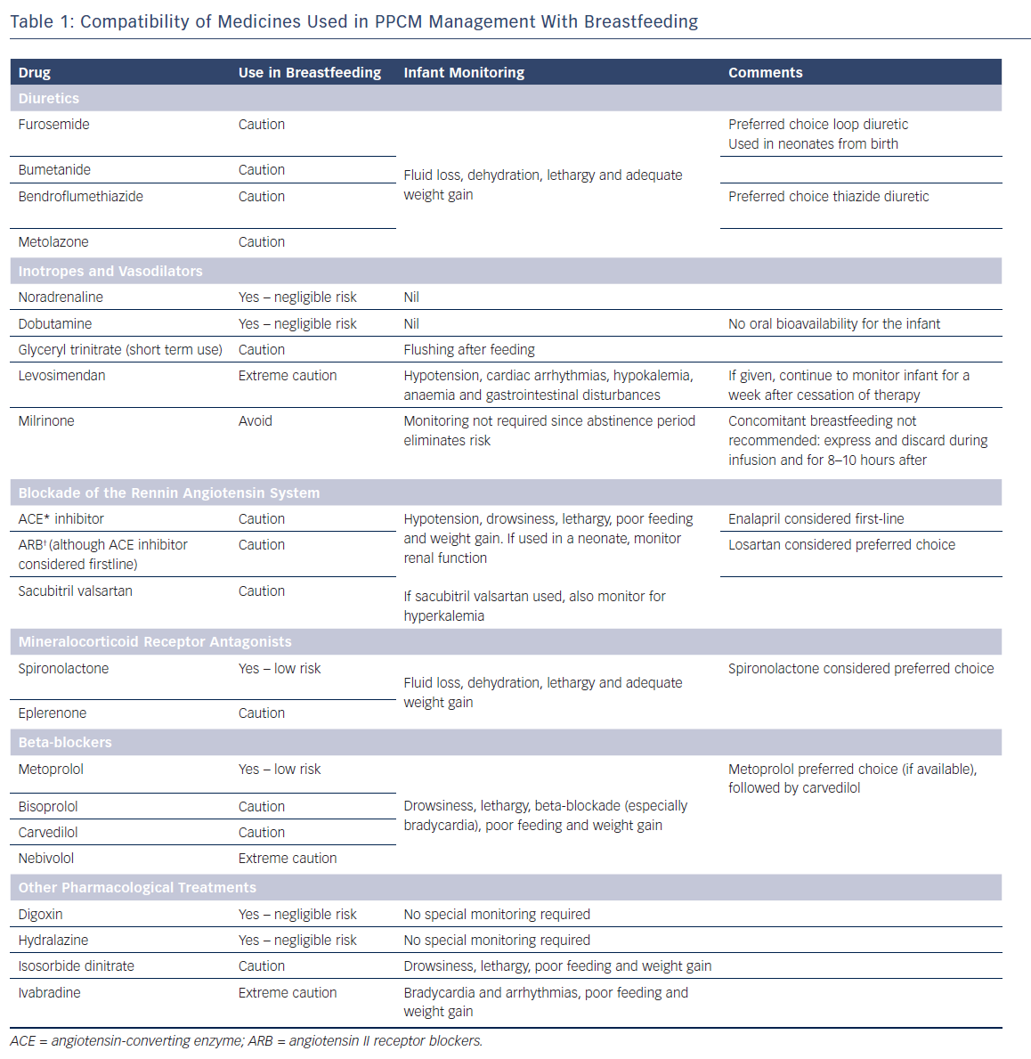
Kearney L, Wright P, Fhadil S, Thomas M
PPCM Management with Breastfeeding
Citation: Cardiac Failure Review 2018;4(2):112–8.
https://doi.org/10.15420/cfr.2018.21.2

