Slide 1
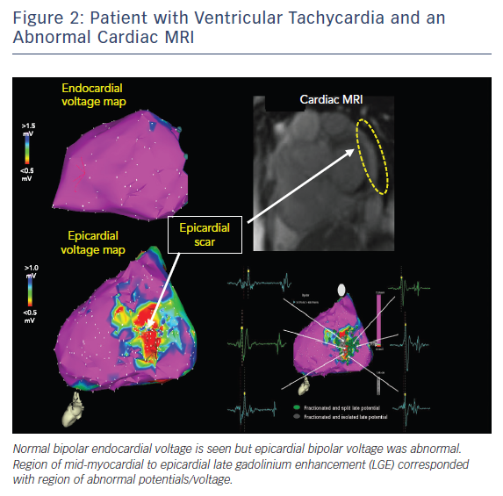
Kumareswaran R, Marchlinski FE
Patient with Ventricular Taachycardia &amp; ab Abnormal Cardic MRI
Citation: Arrhythmia & Electrophysiology Review 2018;7(3):159–64.
https://doi.org/10.15420/aer.2018.10.2

