Slide 1
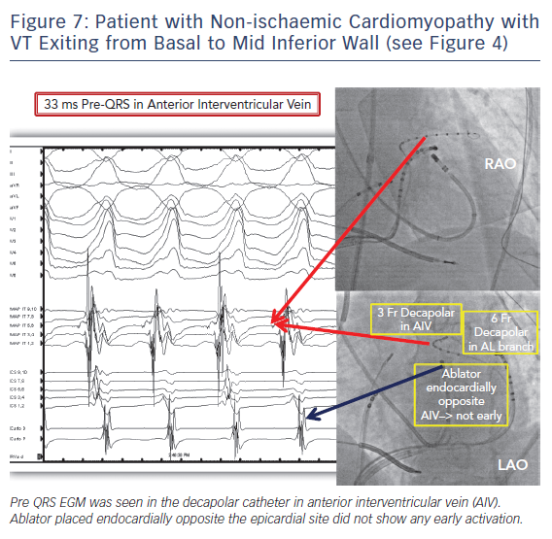
Kumareswaran R, Marchlinski FE
Patient with Non-ischaemic Cardiomyopathy
Citation: Arrhythmia & Electrophysiology Review 2018;7(3):159–64.
https://doi.org/10.15420/aer.2018.10.2

