Slide 1
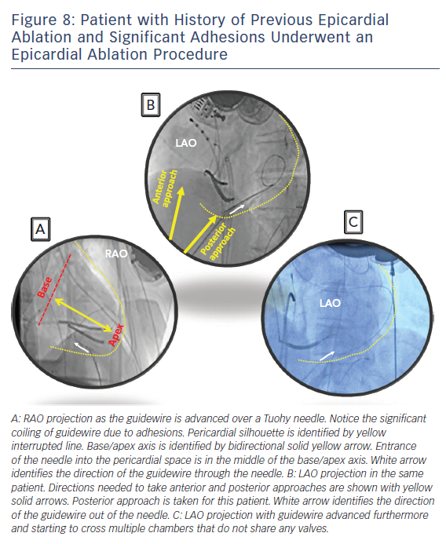
Kumareswaran R, Marchlinski FE
Anterior &amp; Posterior Approach
Citation: Arrhythmia & Electrophysiology Review 2018;7(3):159–64.
https://doi.org/10.15420/aer.2018.10.2

