Slide 1
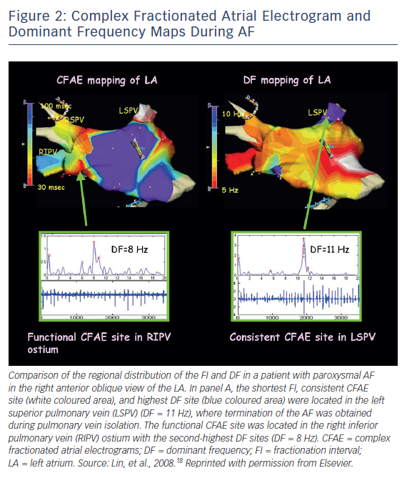
Latchamsetty R, Morady F
Figure 2: Complex Fractionated Atrial Electrogram and Dominant Frequency Maps During AF
Citation: Arrhythmia & Electrophysiology Review 2018;7(3):165–8.
https://doi.org/10.15420/aer:2018:25:2

