Slide 1
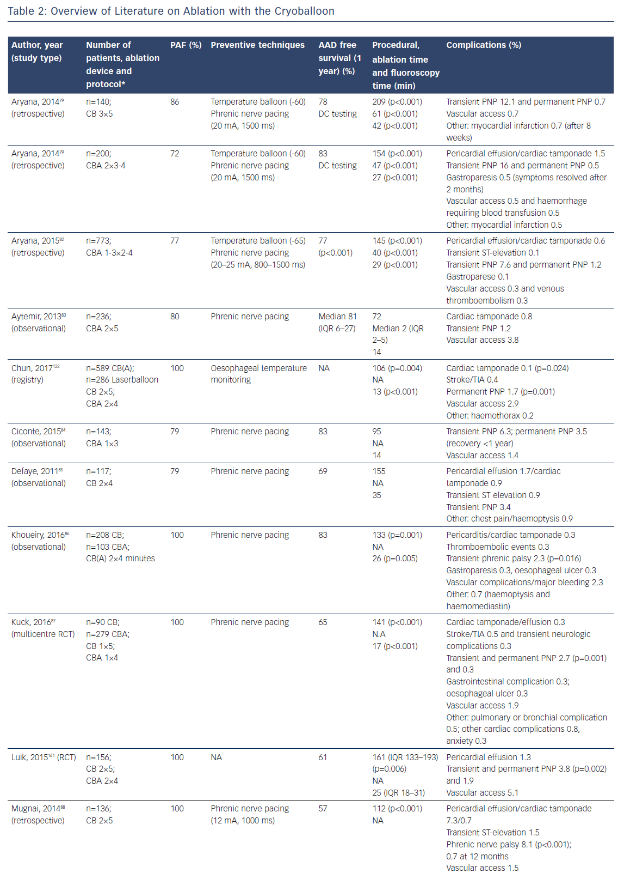
Keçe F, Zeppenfeld K, Trines SA
Overview of Literature on Ablation with the Cryoballoon
Citation: Arrhythmia & Electrophysiology Review 2018;7(3):169–80.
https://doi.org/10.15420/aer.2018.7.3

