Slide 1

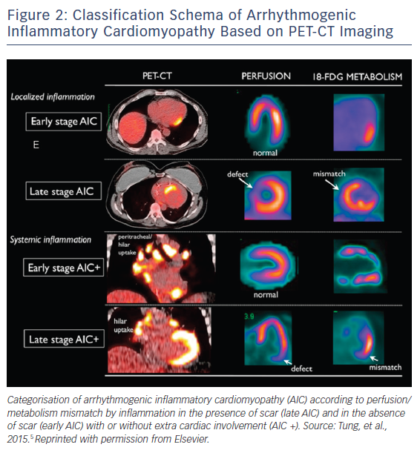
Bauer BS, Li AC, Bradfield JS
Figure 2: Classification Schema of Arrhythmogenic Inflammatory Cardiomyopathy Based on PET-CT Imaging
Citation: Arrhythmia & Electrophysiology Review 2018;7(3):181–6.
https://doi.org/10.15420/aer.2018.26.2

