Slide 1
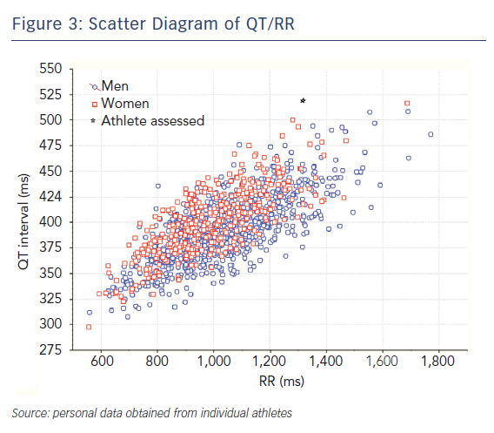
Schnell F, Behar N, Carré F
Figure 3: Scatter Diagram of QT/RR
Citation: Arrhythmia & Electrophysiology Review 2018;7(3):187–92.
https://doi.org/10.15420/aer.2018.39.3

