Slide 1
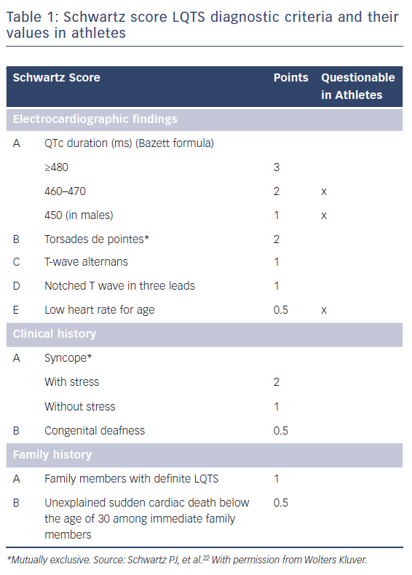
Schnell F, Behar N, Carré F
Table 1: Schwartz score LQTS diagnostic criteria and their values in athletes
Citation: Arrhythmia & Electrophysiology Review 2018;7(3):187–92.
https://doi.org/10.15420/aer.2018.39.3

