Slide 1
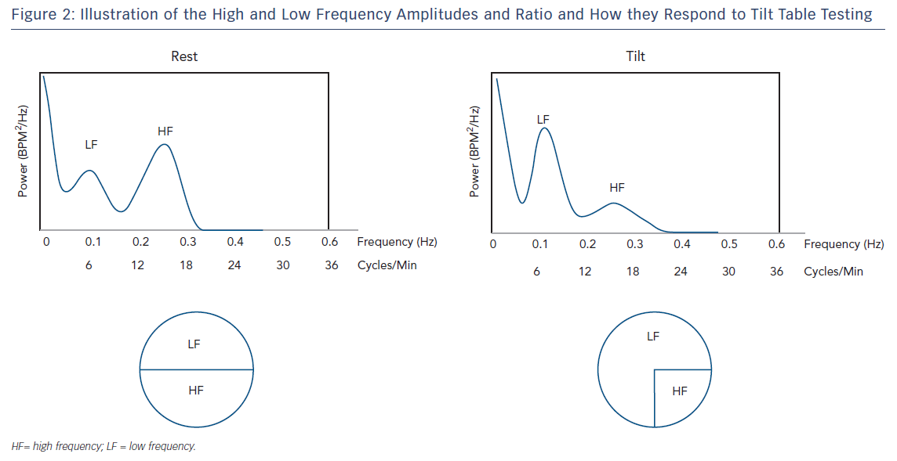
Singh N, Moneghetti KJ, Christle JW, Hadley D, Plews D, Froelicher V
Illustration of the high &amp; Low Frequency Amplitudes and Ration
Citation: Arrhythmia & Electrophysiology Review 2018;7(3):193–8.
https://doi.org/10.15420/aer.2018.27.2

