Slide 1
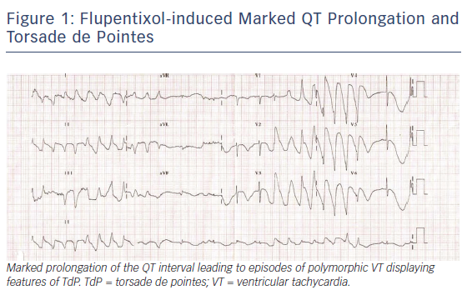
Sicouri S, Antzelevitch C
Flupentixol
Citation: Arrhythmia & Electrophysiology Review 2018;7(3):199–209.
https://doi.org/10.15420/aer.2018.29.2

