Slide 1
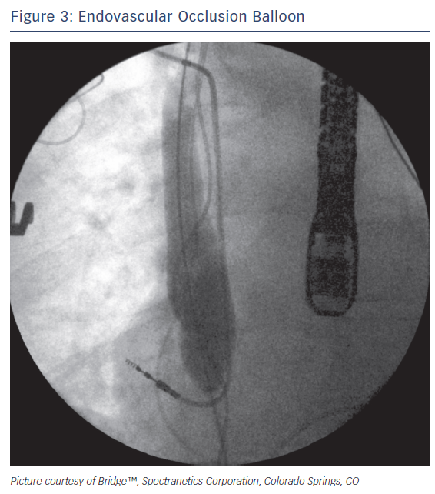
Perez AA, Woo FW, Tsang DC, Carrillo RG
Endovascular Occlusion Ballon
Citation: Arrhythmia and Electrophysiology Review 2018;7(3):210–7.
https://doi.org/10.15420/aer.2018.33.2

