Slide 1
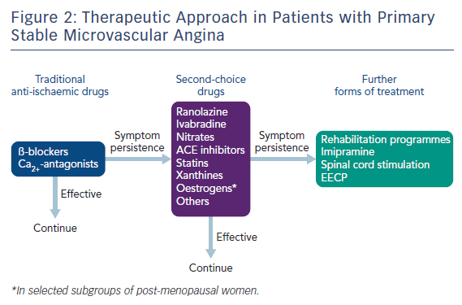
Lanza GA, Kaski JC
Figure 2: Therapeutic Approach in Patients with Primary Stable Microvascular Angina
Citation: Interventional Cardiology Review 2018;13(3):108–11
https://doi.org/10.15420/icr.2018.15.2

