Slide 1
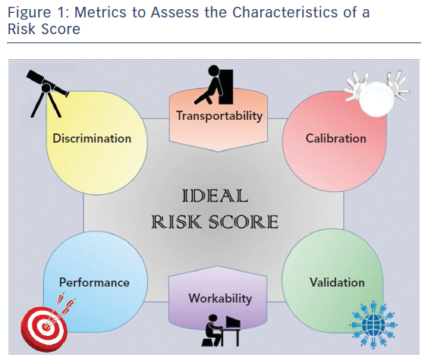
Capodanno D
Figure 1: Metrics to Assess the Characteristics of a Risk Score
Citation: Interventional Cardiology Review 2018;13(3):112–20
https://doi.org/10.15420/icr.2018.16.2

