Slide 1
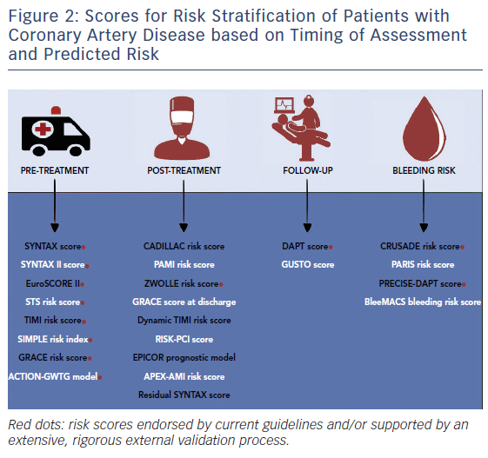
Capodanno D
Figure 2: Scores for Risk Stratification of Patients with Coronary Artery Disease based on Timing of Assessment and Predicted Risk
Citation: Interventional Cardiology Review 2018;13(3):112–20
https://doi.org/10.15420/icr.2018.16.2

