Slide 1
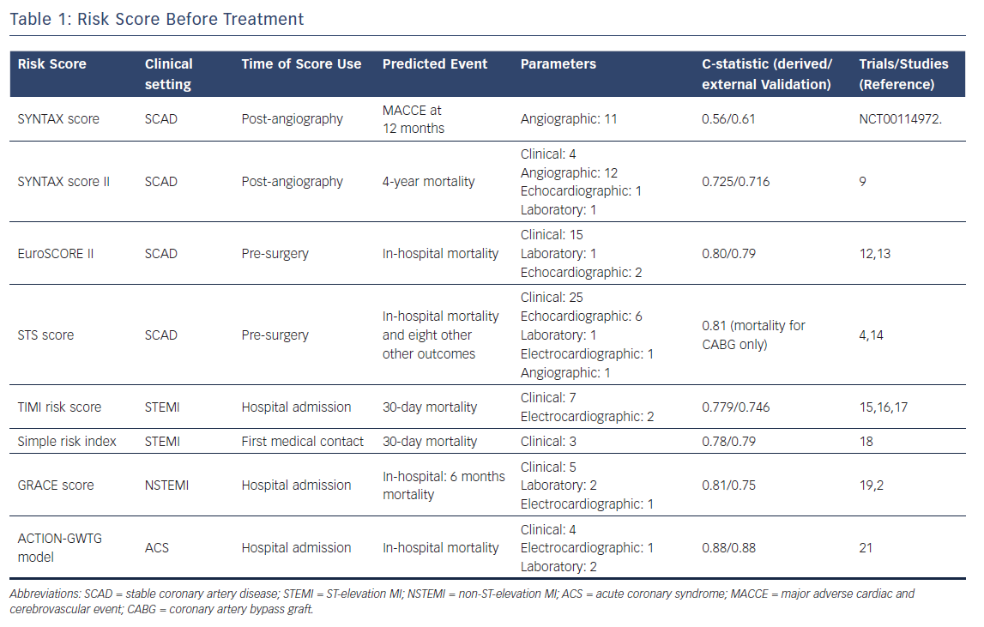
Capodanno D
Table 1: Risk Score Before Treatment
Citation: Interventional Cardiology Review 2018;13(3):112–20
https://doi.org/10.15420/icr.2018.16.2

