Slide 1
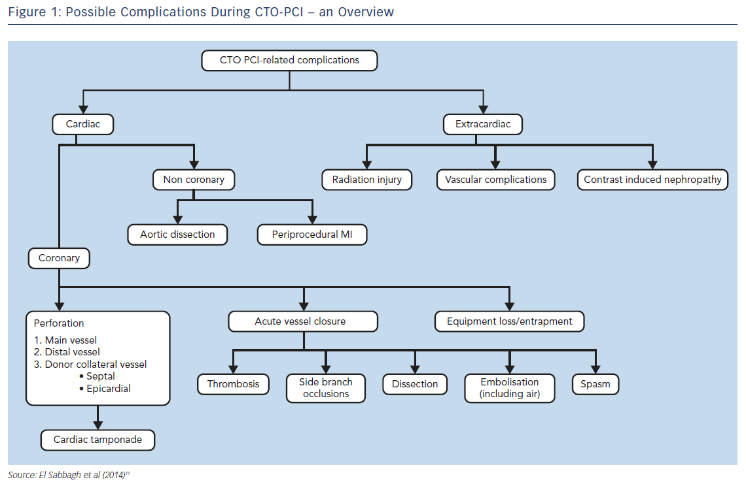
Hanratty C, Walsh SJ
Figure 1: Possible Complications During CTO-PCI – an Overview
Citation: Interventional Cardiology Review 2018;13(3):121–5
https://doi.org/10.15420/icr.2018.10.2

