Slide 1
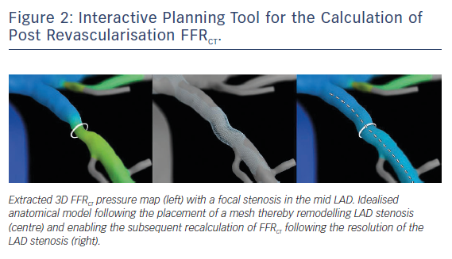
Leipsic J, Weir-McCall J, Blanke P
Figure 2: Interactive Planning Tool for the Calculation of Post Revascularisation FFRCT
Citation: Interventional Cardiology Review 2018;13(3):126-8.
https://doi.org/10.15420/icr.2018.14.3

