Slide 1
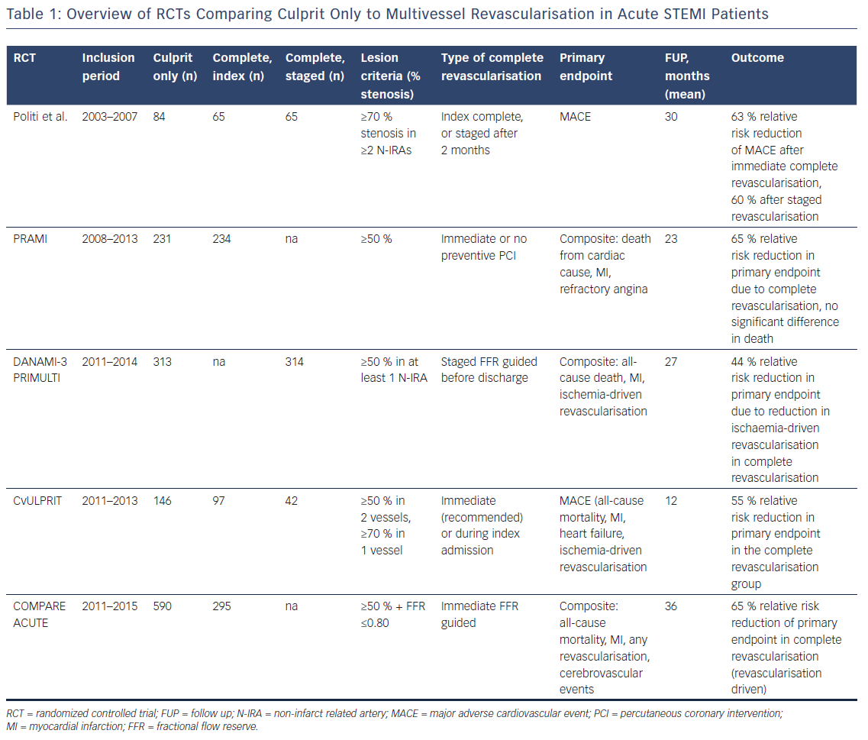
Hasun M, Weidinger F
Table 1: Overview of RCTs Comparing Culprit Only to Multivessel Revascularisation in Acute STEMI Patients
Citation: Interventional Cardiology Review 2018;13(3):129–34.
https://doi.org/10.15420/icr.2018.13.2

