Slide 1
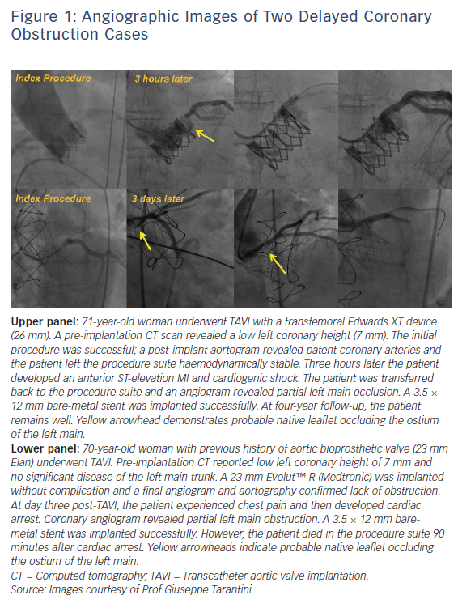
Jabbour RJ, Tanaka A, Colombo A, Latib A
Figure 1: Angiographic Images of Two Delayed Coronary Obstruction Cases
Citation: Interventional Cardiology Review 2018;13(3):137–9.
https://doi.org/10.15420/icr.2018.24.2

