Slide 1
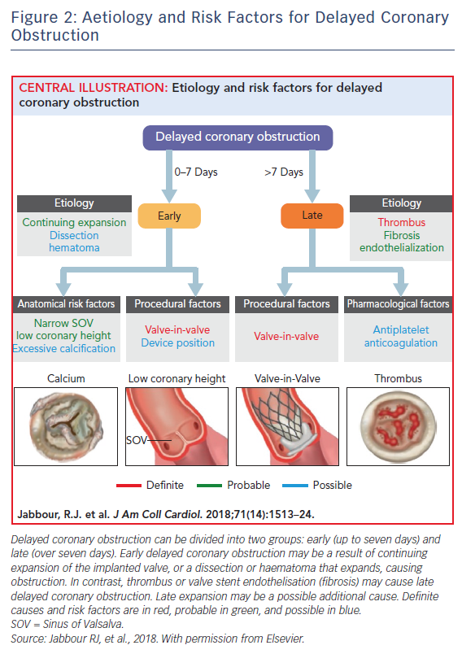
Jabbour RJ, Tanaka A, Colombo A, Latib A
Figure 2: Aetiology and Risk Factors for Delayed Coronary Obstruction
Citation: Interventional Cardiology Review 2018;13(3):137–9.
https://doi.org/10.15420/icr.2018.24.2

