Slide 1
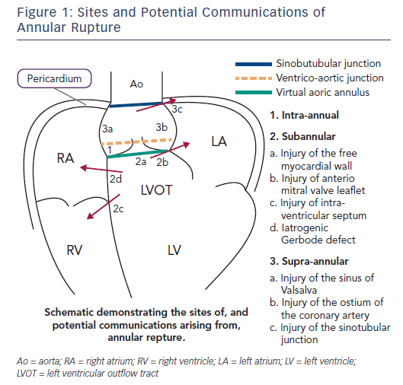
Coughlan J, Kiernan TJ, Mylotte D, Arnous S
Annular Rupture During Transcatheter Aortic Valve Implantation: Predictors, Management and Outcomes
Citation: Interventional Cardiology Review 2018;13(3):140–4
https://doi.org/10.15420/icr.2018.20.2

