Slide 1
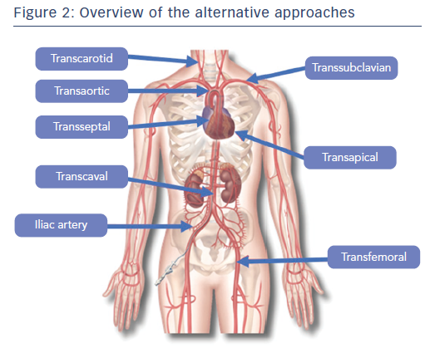
Overtchouk P, Modine T
Figure 2: Overview of the alternative approaches
Citation: Interventional Cardiology Review 2018;13(3):145–50
https://doi.org/10.15420/icr.2018.22.1

